Slide 1

Data Visualization
Chris Piech
CS106A, Stanford University

Slide 2
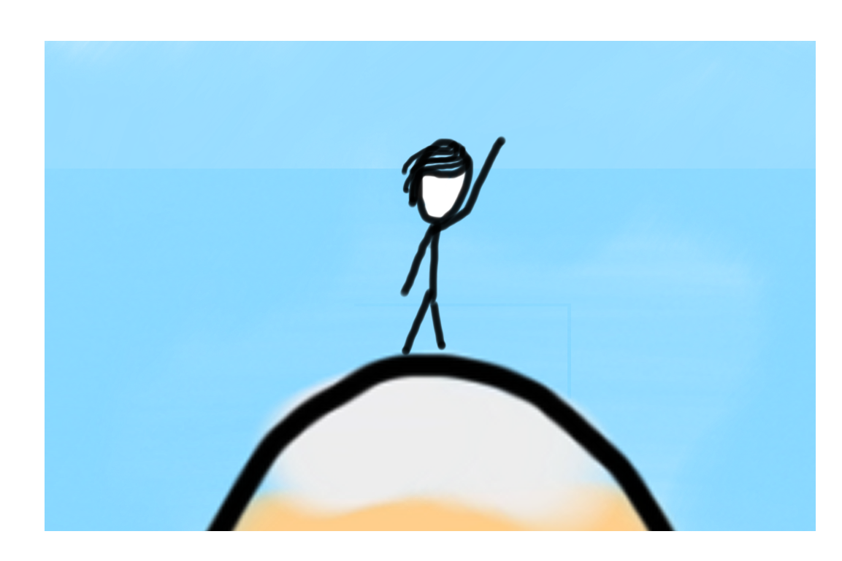
Learning Goals
Be able to create a variable type from scratch

Slide 3
A class defines a new variable type

Slide 4
You must define three things
1. What variables does each instance store?
2. What methods can you call on an instance?
3. What happens when you make a new one?
*details on how to define these three things coming soon

Slide 5
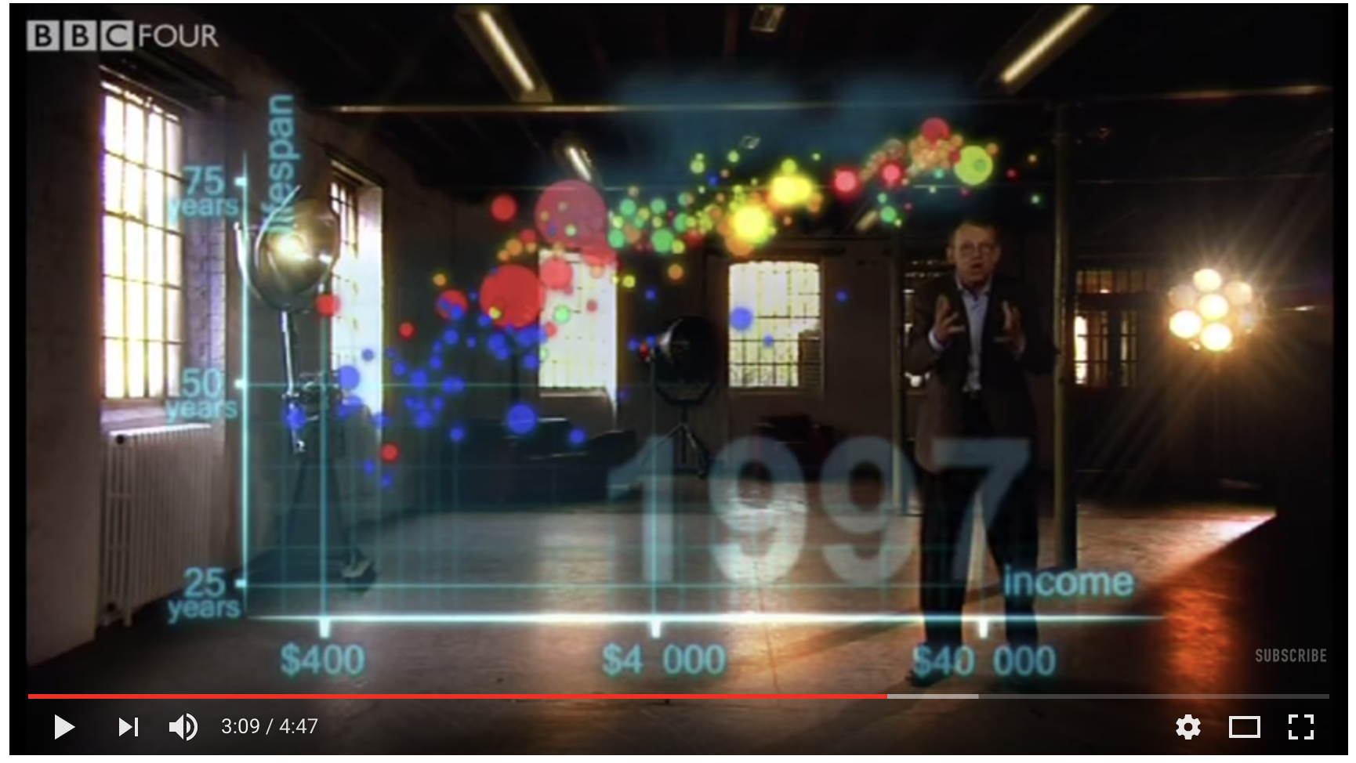
https://www.youtube.com/watch?v=jbkSRLYSojo

Slide 6
extends
Make a class inherit all the
instance variables and methods
of another class

Slide 7
public class Simulator extends GraphicsProgram {
// class definition
}

Slide 8
public class GRect extends GObject {
// class definition
}

Slide 9
implements
I promise that this class will define
a few given methods

Slide 10
public class GRect extends GObject implements GFillable {
// class definition
}

Slide 11
Also a cheeky way to share constants between classes
implements
I promise that this class will define
a few given methods

Slide 12
public class NameSurferDatabase
implements NameSurferConstants {
// class definition
}

Slide 13
Integer.parseInt(“52”)
Math.sqrt(16);
static
This method isn’t called on an instance.

Slide 14
public class BubbleMaker {
public static GOval makeBubble(Country country,
int year){
double gdp = country.getGdp(year);
double life = country.getLifeExpectancy(year);
double pop = country.getPop(year);
return makeBubbleHelper(gdp, life, pop);
}
}

